Slide 1

Gesture Control Virtual Mouse
DEPARTMENT OF COMPUTER SCIENCE
Project Presentation (KCS 753)
Guide Name : Mr. Pradeep Tyagi
Deepanshu Singh (2000290120061) A
Ayush Kumar(2000290120053) A

Slide 2
Problem Statement
In the world where, there isn't enough room to use a physical mouse or for those who have hand difficulties and can't use a mouse, the proposed AI virtual mouse system frequently wants to circumvent challenges. The COVID-19 condition also makes it risky to utilize gadgets by touching them because doing so might result in an instance in which the virus is on them. Because hand gestures and hand unfolded detection are utilized to control the laptop mouse operations by utilizing a digital camera or tip intrinsic camera, the suggested AI virtual mouse may be used to resolve these concerns.
Of course, like any technology, Gesture-Based Control has its challenges. Fine-tuning gesture recognition algorithms, reducing false positives, and improving accuracy are ongoing areas of research.

Slide 3
Objectives
To design and implement a system that can control the mouse cursor using hand gestures and voice commands captured by a webcam.
To improve human-computer interaction by reducing the need for physical contact with the computer or laptop.
To enable the user to perform various mouse functions such as moving, clicking, dragging, scrolling, and selecting using different hand gestures and voice assistant.
Enhance Hygiene Practices: Enable users to navigate computer interfaces, interact with applications, and perform tasks without touching physical input devices like mice and keyboards, promoting better hygiene practices and reducing the spread of infectious diseases.
Focus on improving the overall user experience by providing responsive, accurate, and intuitive control over digital devices through gestures and voice.

Slide 4
Technology Used
The core of Gesture-Based Control is a technology called Mediapipe, which allows us to track the movement of our hands with remarkable precision. This technology is developed by Google and is designed to work with webcams, making it accessible to a wide range of devices.
1. cv2
-OpenCV library, which is used for computer vision tasks, including image and video processing.
2. mediapipe
- Mediapipe library, which provides tools for building various machine learning and computer vision applications.
3. pyautogui
- PyAutoGUI library, which allows you to programmatically control the mouse and keyboard for automation tasks.

Slide 5
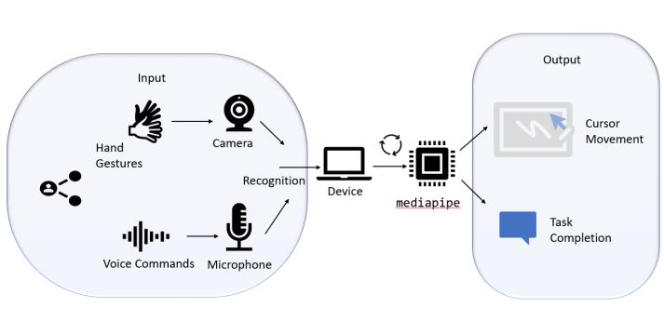
Workflow Diagram

Slide 6
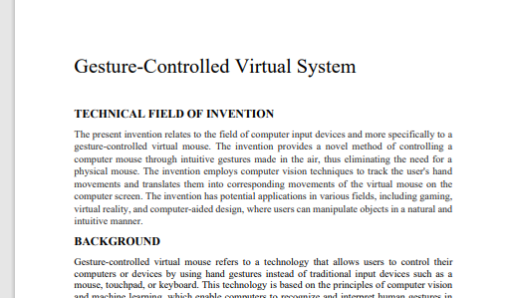
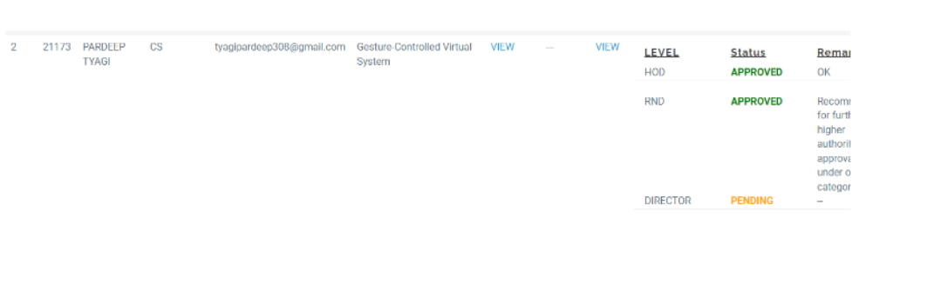
Patent Status
Draft completion status: Submitted
Soft copy proof of submission

Slide 7
Research Paper Status
Draft completion status :Completed and Submitted to Guide

Slide 8
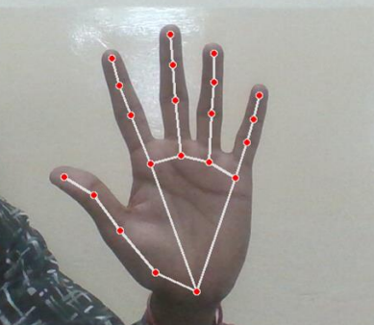

Project Status
Input
Output

Slide 9
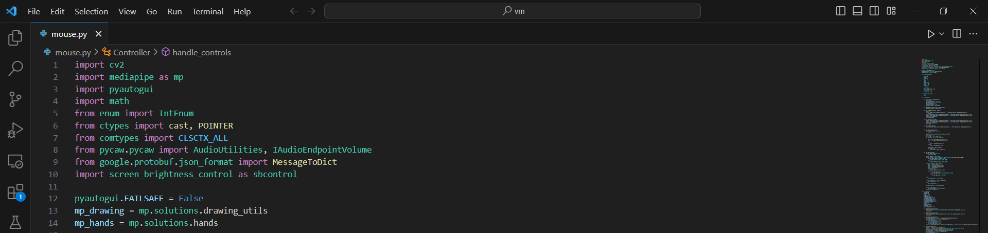
Screenshot of code

Slide 10
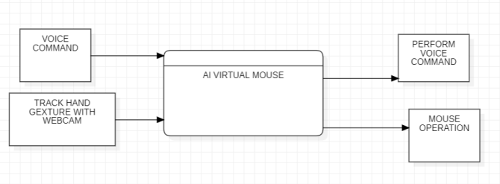
DFD
DFD LEVEL 0

Slide 11
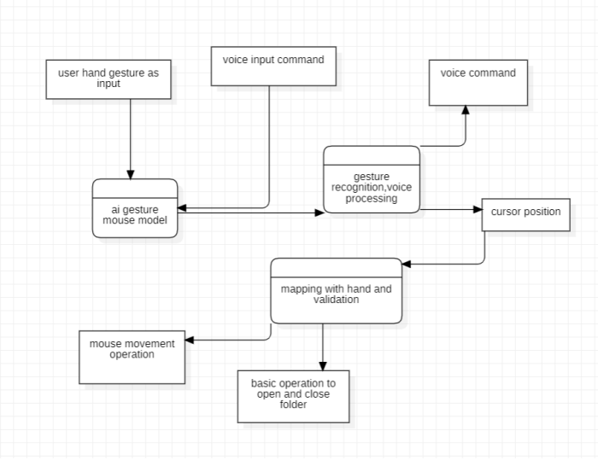
DFD LEVEL 1

Slide 12
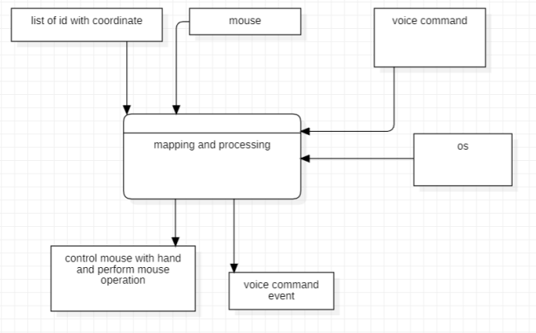
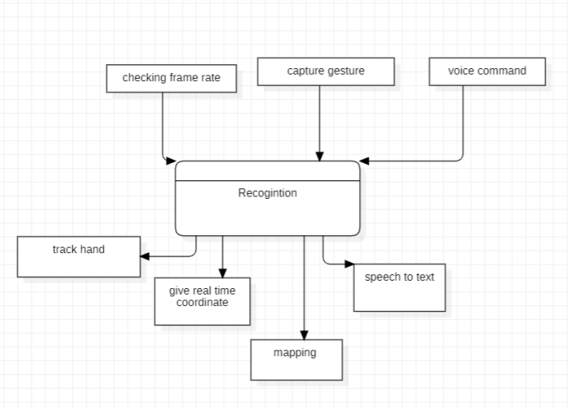
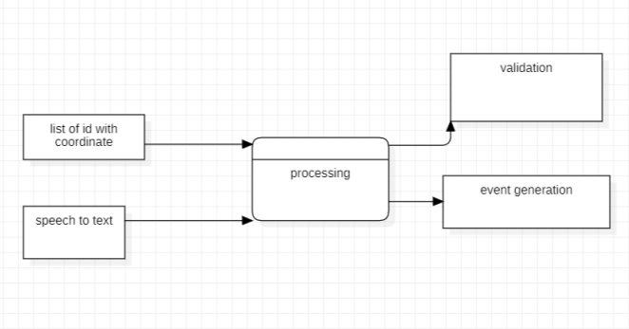
DFD LEVEL 2

Slide 13
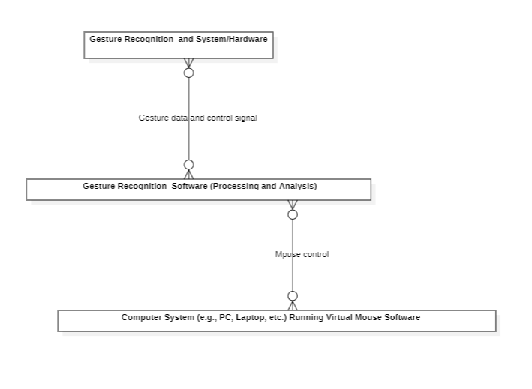
ER diagram

Slide 14
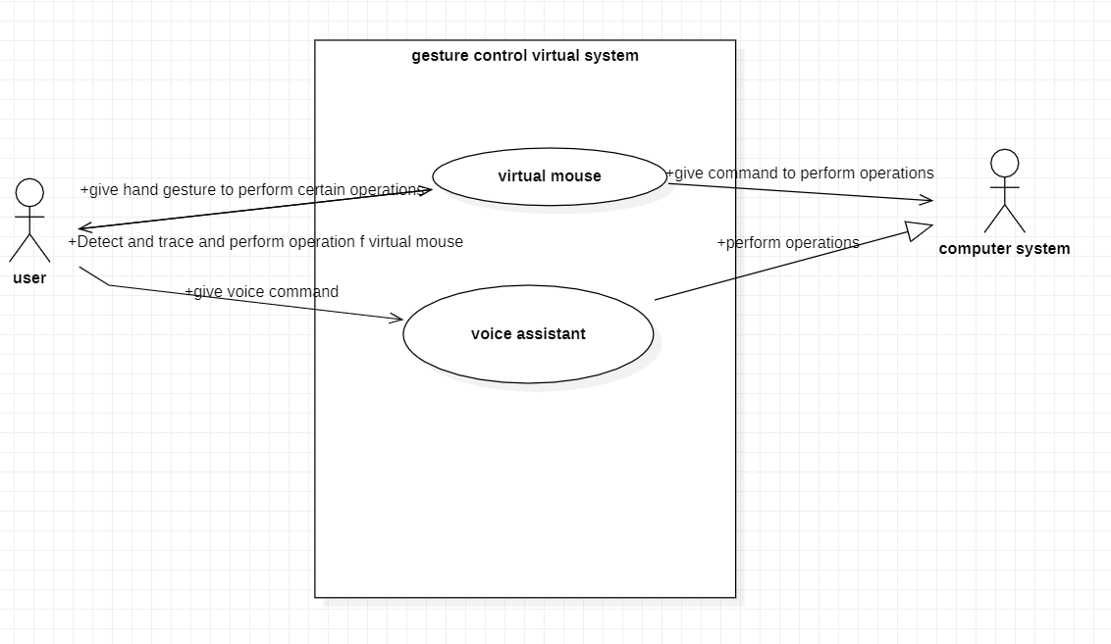
USE CASE

Slide 15
References
[1] |  |  | D.-H. L. &. D. L. Chiung Hsieh, "A real time hand gesture recognition system using motion history image," roc. IEEE Int'l Conf. Signal Processing Systems (ICSPS), 2.10.1109/ICSPS.2010.5555462, 2010.
[2] |  |  | L. Thomas, "Virtual mouse using hand gesture," International Research Journal of Engineering and Technology (IRJET), vol. 5, p. 4, 2018.
[3] |  |  | P. I. J. T. e. Varun KS, "Virtual Mouse Implementation using Open CV," Proceedings of the Third International Conference on Trends in Electronics and Informatics (ICOEI 2019), no. IEEE, 2019.
[4] |  |  | L. M. B. B. e. Križnar V, "Use of Computer Vision Based Hand Tracking in Educational Environments," 44th International Convention on Information, Communication and Electronic Technology (MIPRO), no. IEEE, 2021.
[5] |  |  | K. S. V. S. Guha J, "AI Virtual Mouse Using Hand Gesture Recognition," International Journal for Research in Applied Science & Engineering Technology, 2022.

Slide 16
Thank You

